Slide 1

UNIVERSITY INSTITUTE OF ENGINEERING
DEPARTMENT OF COMPUTER SCIENCE AND ENGG.
Bachelor of Engineering (Computer Science & Engineering)
DATA STRUCTURES 22CSH-211/22ITH-211
THREADS
TREES
DISCOVER . LEARN . EMPOWER

Slide 2
Threaded Binary Tree
In the linked representation of binary trees, more than one half of the link fields contain NULL values which results in wastage of storage space.
If a binary tree consists of n nodes then n+1 link fields contain NULL values. So in order to effectively manage the space, a method was devised by Perlis and Thornton in which the NULL links are replaced with special links known as threads. Such binary trees with threads are known as threaded binary trees.
Each node in a threaded binary tree either contains a link to its child node or thread to other nodes in the tree.

Slide 3
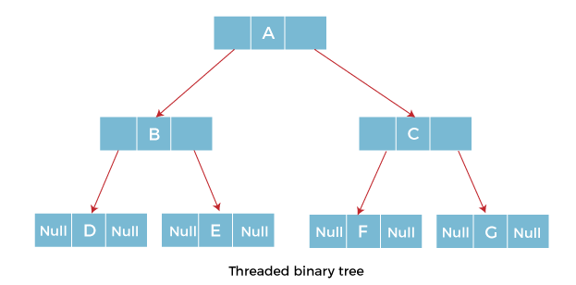

Slide 4
Types of Threaded Binary Tree
One-way threaded Binary Tree
Two-way threaded Binary Tree

Slide 5
One-way threaded Binary trees
In one-way threaded binary trees, a thread will appear either in the right or left link field of a node.
If it appears in the right link field of a node then it will point to the next node that will appear on performing in order traversal. Such trees are called Right threaded binary trees.
If thread appears in the left field of a node then it will point to the nodes inorder predecessor. Such trees are called Left threaded binary trees.
Left threaded binary trees are used less often as they don't yield the last advantages of right threaded binary trees.
In one-way threaded binary trees, the right link field of last node and left link field of first node contains a NULL. In order to distinguish threads from normal links they are represented by dotted lines.

Slide 6
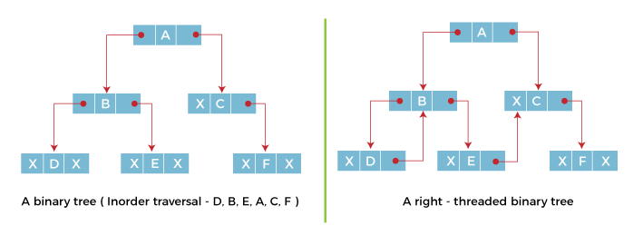
The above figure shows the inorder traversal of this binary tree yields D, B, E, A, C, F. When this tree is represented as a right threaded binary tree, the right link field of leaf node D which contains a NULL value is replaced with a thread that points to node B which is the inorder successor of a node D. In the same way other nodes containing values in the right link field will contain NULL value.

Slide 7
Two-way threaded Binary Trees
In two-way threaded Binary trees, the right link field of a node containing NULL values is replaced by a thread that points to nodes inorder successor and left field of a node containing NULL values is replaced by a thread that points to nodes inorder predecessor.

Slide 8
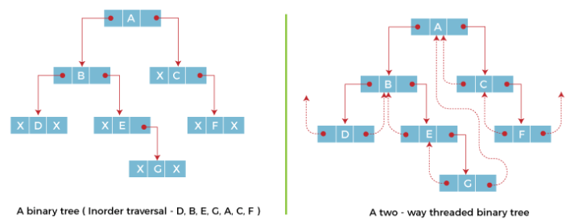
The above figure shows the inorder traversal of this binary tree yields D, B, E, G, A, C, F. If we consider the two-way threaded Binary tree, the node E whose left field contains NULL is replaced by a thread pointing to its inorder predecessor i.e. node B. Similarly, for node G whose right and left linked fields contain NULL values are replaced by threads such that right link field points to its inorder successor and left link field points to its inorder predecessor. In the same way, other nodes containing NULL values in their link fields are filled with threads.

Slide 9
References
Li`pschutz, Seymour, “Data Structures”, Schaum's Outline Series, Tata McGraw Hill.
Data structure and algorithm by Narasimha Karumanchi.
www.tutorialspoint.com
www.geeksforgeeks.com
9

Slide 10
Books Recommended
Goodrich, Michael T., Tamassia, Roberto, and Mount, David M., “Data Structures and Algorithms in C++”, Wiley Student Edition.
Aho, Alfred V., Ullman, Jeffrey D., Hopcroft ,John E. “Data Structures and Algorithms”, Addison Wesley
Lipschutz, Seymour, “Data Structures”, Schaum's Outline Series, Tata McGraw Hill.
Gilberg/Forouzan,” Data Structure with C ,Cengage Learning.
Augenstein,Moshe J , Tanenbaum, Aaron M, “Data Structures using C and C++”, Prentice Hall of India

Slide 11
THANK YOU

